Slide 1

Image Authentication Based on Steganography Approach
Name- Mahum Fareed Khan
PRN-20070123117
Branch-ENTC
Div.-B
Batch-2020-2024

Slide 2
Introduction
Steganography is a technique for image authentication in which secret information is embedded in an image, which can then be removed and examined to validate the image's legitimacy.
This procedure guarantees no tampering has occurred, since any tampering would disrupt the embedded data.

Slide 3
Embedding Process
Secret Data: A watermark, hash, or any relevant data is chosen to be embedded into the image.
Steganographic Technique: LSB (Least Significant Bit) was used for hiding a binary message image within the cover image
Embedding: The secret data is embedded into the image, typically in a way that is imperceptible to the human eye. The image appears unchanged, but it now contains the hidden data.

Slide 4
Authentication Process
Extraction: The hidden data is extracted from the image using the inverse of the embedding technique.
Verification: The extracted data is compared with the original data (or some known standard). If the data matches, the image is deemed authentic.
Tamper Detection: If the image has been altered, the extracted data will differ, signalling that the image has been tampered with.

Slide 5


Slide 6
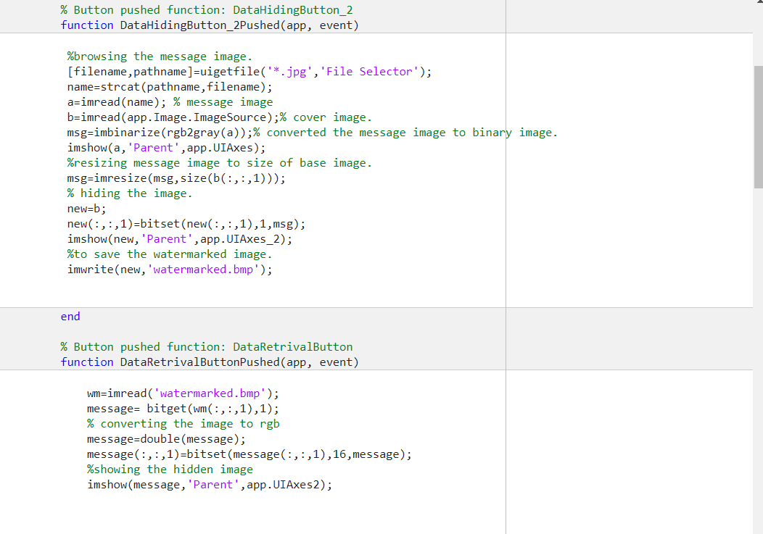
Code

Slide 7
Conclusion
This technique demonstrates the effectiveness of LSB (Least Significant Bit) steganography in hiding a binary message within a cover image.

